Slide 1
Module 04 Data Provenance

Slide 2
Steps in Data Analysis
Before Analysis
During Analysis
After Analysis
Define the question
Define the ideal data set
Determine what data you can access
Obtain the data
Clean the data
Exploratory data analysis
Statistical prediction/modeling
Interpret results
Challenge results
Synthesize/write-up results
Create reproducible code
Make data and code publicly available

Slide 3
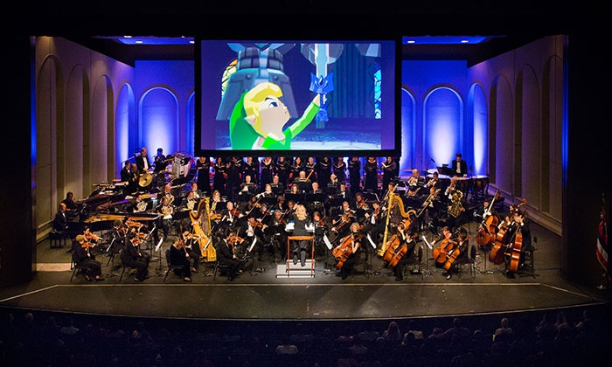

Slide 4
Before analysis

Slide 5
Data Provenance (in the past)
Knowing where your data came from
Data Source(s)
Record who carried out each experiment, at what date and time, how to contact them
Record the model and make information for any equipment used

Slide 6
Data Provenance (in the past)
Data Storage and Management
If you expect your project to include big data, by any definition - volume, velocity, or variety - plan up front for how you’ll manage it
If working with big data, consider a distributed file system and parallel processing, as well as streamed processing that can save progress, start, and stop as needed
If your data change frequently, include an explicit annotation process, automated if possible, that captures where new files are coming from, at what time, and who’s responsible for them
If you’re working with many different kinds of data, consider using a data store such as the Open Science Data Framework that provides detailed typing, metadata, and cross-file integration

Slide 7
Experimental Design
Research Questions / Hypotheses
Should have several in mind
Should relate to the knowledge gap are you trying to fill
Should be coherent and focused
Data Acquisition
Consider population structure and confounding
Ensure you’ll have data available for validation in the future
Balance time and monetary budgets against the number of data points generated or conditions tested
Carry out power calculations
If limited to a particular data set(s) that don’t provide information needed to answer your research question, you may need to change your research question or hypothesis

Slide 8
Experimental Design
Analysis Infrastructure
Choose a formal scientific workflow environment
Find and install software (text editor, development environment, task tracking, documentation, and communication tools) that will facilitate your day-to-day work
Set up a revision control repository for the project (GitHub, BitBucket, etc.)
Create a directory and folder structure
Store files in a consistent and intuitive manner
Include a README file that contains information about all other files in your repository

Slide 9
Assessment #1
You are interested in investigating the association between age and developing toxemia during pregnancy for a group of mothers. After receiving the data set, you realize an indicator of toxemia was not recorded. However, the data set does include the variables that indicate the presence or absence of hypertension, diabetes and edema.
Identify the problem and propose a possible solution.

Slide 10
Assessment #1
You are interested in investigating the association between age and developing toxemia during pregnancy for a group of mothers. After receiving the data set, you realize an indicator of toxemia was not recorded. However, the data set does include the variables that indicate the presence or absence of hypertension, diabetes and edema.
Identify the problem and propose a possible solution.
The data do not provide the necessary information needed to answer the scientific question. A possible solution would be to come up with another, similar question that you can answer with the data available. For the maternal health example, you could use the information available to create a likelihood of toxemia score for each mother and study the association between that score and age of the mother.

Slide 11
During analysis

Slide 12
Data Provenance (in the present)
Knowing what you did and where that information is stored
Provenance Tracking Infrastructure
Ensure you have infrastructure for at least the following three aspects of your research
Analysis commands you can run as part of your main workflow
Data that is produced by these, or other, commands
Lab notebook for everything else
Use a supplemental provenance annotation system and/or environment for formal data provenance
JSON, XML, W3C PROV, Open Provenance Model
Taverna, Open Science Data, MyGrid
Data Quality Control
Document the actions performed to achieve a clean data set
Use workflow environments like Doit, Luigi, Taverna, Galaxy, etc.

Slide 13
Workflow Documentation
Practice literate programming and extensively document all code
Choose easily interpretable variable names
Make use of version control
GitHub, Google Docs, Etherpad, etc.
Make code and workflow as automated as possible
Use driver scripts
Use platforms like R Markdown, Jupyter notebook, etc.
Incorporate positive and negative controls throughout the analysis
Consider using a shared file service
Dropbox, Google Drive, OneDrive, etc.

Slide 14
Verify Analysis Methods
Avoid overfitting using a variety of methods
Cross-validation
Regularization
Bootstrapping

Slide 15
Assessment #2
Identify the following as either a positive or negative control.
1. You have written a function that transforms birth dates (MM/DD/YYYY) into age (Years). You input 10 different birth dates and find that your function outputs the correct ages in years.
2. You derive a new test statistic and write a function to calculate its value. You calculate the test statistic for a data set that you know is not significant under the null, and find that it is indeed not significant.
3. You create a test to detect cancer cells. You run the test on a batch of healthy, non-cancerous cells and find the test result is negative.

Slide 16
Assessment #2
Identify the following as either a positive or negative control.
1. You have written a function that transforms birth dates (MM/DD/YYYY) into age (Years). You input 10 different birth dates and find that your function outputs the correct ages in years.

Slide 17
Assessment #2
Identify the following as either a positive or negative control.
1. You have written a function that transforms birth dates (MM/DD/YYYY) into age (Years). You input 10 different birth dates and find that your function outputs the correct ages in years. Positive control

Slide 18
Assessment #2
Identify the following as either a positive or negative control.
2. You derive a new test statistic and write a function to calculate its value. You calculate the test statistic for a data set that you know is not significant under the null, and find that it is indeed not significant.

Slide 19
Assessment #2
Identify the following as either a positive or negative control.
2. You derive a new test statistic and write a function to calculate its value. You calculate the test statistic for a data set that you know is not significant under the null, and find that it is indeed not significant. Negative control

Slide 20
Assessment #2
Identify the following as either a positive or negative control.
3. You create a test to detect cancer cells. You run the test on a batch of healthy, non-cancerous cells and find the test result is negative.

Slide 21
Assessment #2
Identify the following as either a positive or negative control.
3. You create a test to detect cancer cells. You run the test on a batch of healthy, non-cancerous cells and find the test result is negative. Negative control

Slide 22
After analysis

Slide 23
Data Provenance (in the future)
How you’ll make your data and code available over the long term
Data Publication
Cite your data
If needed, anonymize or de-identify data
Consider who will have access to the data
Consider if your data will be available long-term and how (where it will be stored)
GitHub, Dataverse, Figshare, etc.
As part of the supplementary material for a journal article
Your own private web site
If providing raw, anonymized or de-identified data is not possible (i.e. proprietary data), provide a synthetic data set that can be used in its place

Slide 24
Data Provenance (in the future)
Code Publication
Ensure your code is well documented and commented
Consider who will be maintaining your software in the future and how
Consider how your code will be available
GitHub, BitBucket, etc.
As part of the supplementary material for a journal article
Your own private web site

Slide 25
Verification
Verify Analysis Results
Implement positive and negative results checks
Conduct simulation studies
Sensitivity analyses
Implementation Checks
Ask at least one person to re-run your analysis and gauge how much effort it takes to implement
Ensure at least one person knows the basics of what data and methods are stored and how they are documented
If possible, re-run your analysis using new and/or different software

Slide 26
Privacy
Privacy is the need to protect sensitive information
Security is the mechanism(s) by which information is protected
Anonymization of records is one step that can protect them during research, referring to any method of manipulating the dataset that masks these unique identifiers or prevents them from being correctly linked to their associated medical records
De-identification is one of the most common forms of anonymization, in which all such identifiers are removed completely

Slide 27
Some alarming statistics
Using data from the 1990 U.S. Census summary, it was found that some individuals could be relatively easily identified
87% of the population could be uniquely identified based only on {5-digit ZIP, gender, date of birth}
53% could be uniquely identified by only {place, gender, date of birth} where place I a city, town or municipality
18% could be uniquely identified by only {county, gender, date of birth}

Slide 28
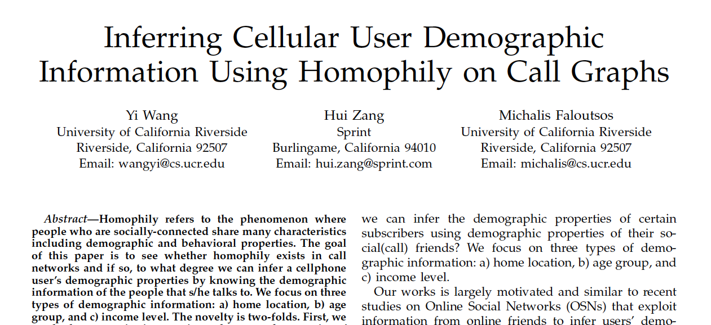

Slide 29
Homophily is the tendency of individuals to associate and bond with similar others, as in the proverb "birds of a feather flock together”
“We develop effective methods to infer demographic information for a cellular user using linear regression to select the most homophily-like friend of her/him”
“We find that we can predict home location within 20km radius with 80% accuracy, and age group and income level with 78% and 72% accuracy, respectively”

Slide 30
Data Breaches
These happen a lot more often than you’d think …

Slide 31
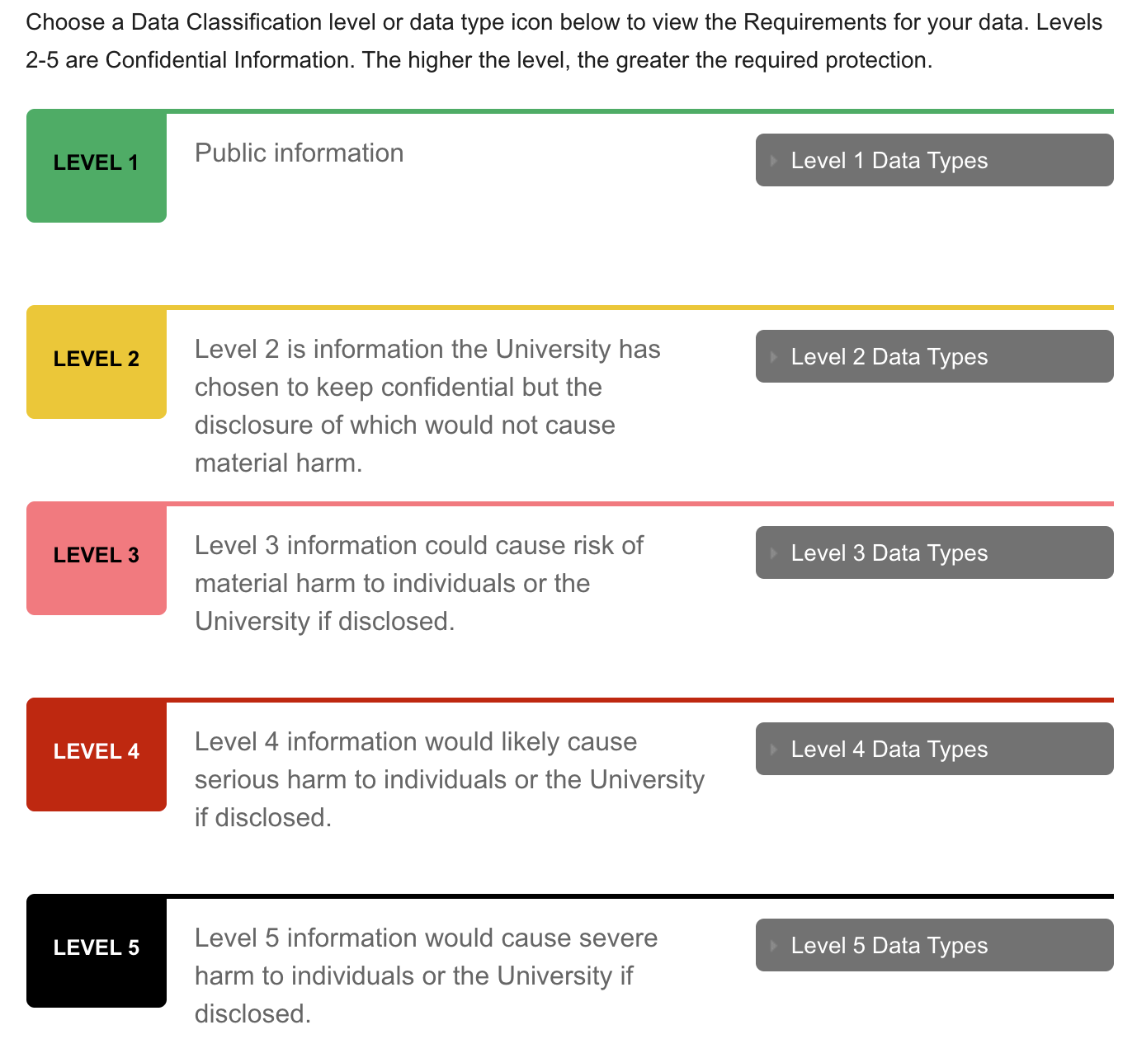
Harvard’s Information Security Policy

Slide 32
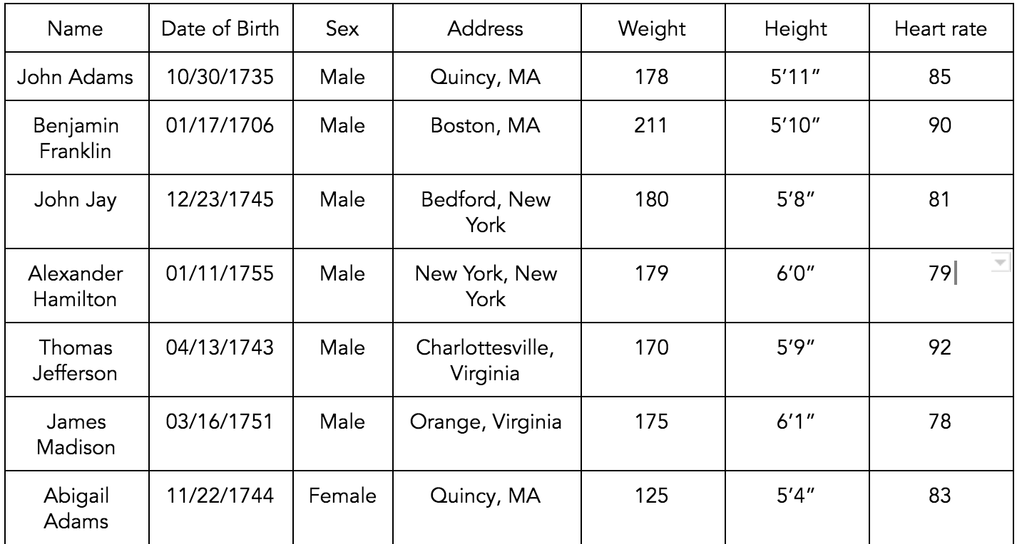
Assessment #3
De-identify and clean the data contained in the table below

Slide 33
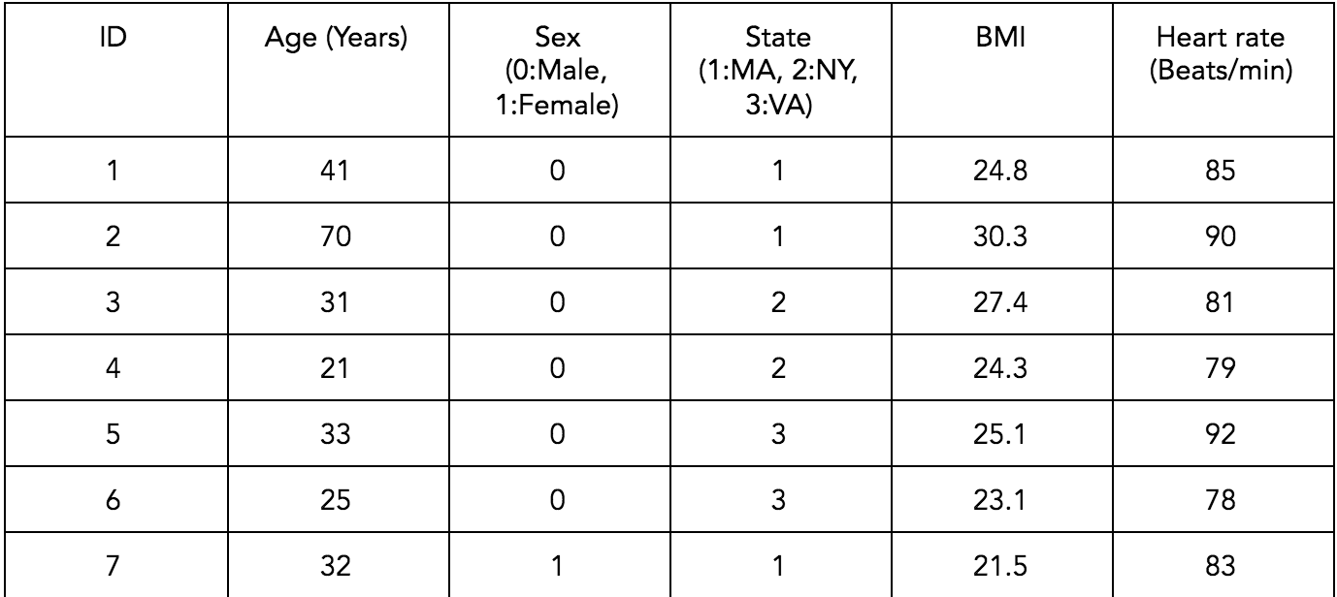
Assessment #3
One possible answer

Slide 34
Assessment #5
Choose which tier (1-5) the following example data sets would fall into according to the Harvard University Information Security Policy.
A. Identifiable medical records that include age, sex and mental health details of all patients at Mass General Hospital.
B. A data set including the date, time, duration, location and category of tornadoes in Oklahoma in 2011.
C. Identifiable financial records including credit card numbers and social security numbers of people living in Los Angeles, CA.
D. The de-identified employment history of all adults 18-70 in Massachusetts.
E. A data set detailing microorganisms used for not yet published research.

Slide 35
Assessment #5
Choose which tier (1-5) the following example data sets would fall into according to the Harvard University Information Security Policy.
A. Identifiable medical records that include age, sex and mental health details of all patients at Mass General Hospital. Tier 5
B. A data set including the date, time, duration, location and category of tornadoes in Oklahoma in 2011.
C. Identifiable financial records including credit card numbers and social security numbers of people living in Los Angeles, CA.
D. The de-identified employment history of all adults 18-70 in Massachusetts.
E. A data set detailing microorganisms used for not yet published research.

Slide 36
Assessment #5
Choose which tier (1-5) the following example data sets would fall into according to the Harvard University Information Security Policy.
A. Identifiable medical records that include age, sex and mental health details of all patients at Mass General Hospital. Tier 5
B. A data set including the date, time, duration, location and category of tornadoes in Oklahoma in 2011. Tier 1
C. Identifiable financial records including credit card numbers and social security numbers of people living in Los Angeles, CA.
D. The de-identified employment history of all adults 18-70 in Massachusetts.
E. A data set detailing microorganisms used for not yet published research.

Slide 37
Assessment #5
Choose which tier (1-5) the following example data sets would fall into according to the Harvard University Information Security Policy.
A. Identifiable medical records that include age, sex and mental health details of all patients at Mass General Hospital. Tier 5
B. A data set including the date, time, duration, location and category of tornadoes in Oklahoma in 2011. Tier 1
C. Identifiable financial records including credit card numbers and social security numbers of people living in Los Angeles, CA. Tier 4
D. The de-identified employment history of all adults 18-70 in Massachusetts.
E. A data set detailing microorganisms used for not yet published research.

Slide 38
Assessment #5
Choose which tier (1-5) the following example data sets would fall into according to the Harvard University Information Security Policy.
A. Identifiable medical records that include age, sex and mental health details of all patients at Mass General Hospital. Tier 5
B. A data set including the date, time, duration, location and category of tornadoes in Oklahoma in 2011. Tier 1
C. Identifiable financial records including credit card numbers and social security numbers of people living in Los Angeles, CA. Tier 4
D. The de-identified employment history of all adults 18-70 in Massachusetts. Tier 3
E. A data set detailing microorganisms used for not yet published research.

Slide 39
Assessment #5
Choose which tier (1-5) the following example data sets would fall into according to the Harvard University Information Security Policy.
A. Identifiable medical records that include age, sex and mental health details of all patients at Mass General Hospital. Tier 5
B. A data set including the date, time, duration, location and category of tornadoes in Oklahoma in 2011. Tier 1
C. Identifiable financial records including credit card numbers and social security numbers of people living in Los Angeles, CA. Tier 4
D. The de-identified employment history of all adults 18-70 in Massachusetts. Tier 3
E. A data set detailing microorganisms used for not yet published research. Tier 2

Slide 40
Reproducible Research DOs
Start with good science
Garbage in, garbage out
Coherent, focused questions simplify many problems
Working with good collaborators reinforces good practices
Something that’s interesting to you will (hopefully) motivate good habits
Use version control
Slow things down
Add changes in small chunks (don't just do one massive commit)
Track / tag snapshots; revert to old versions
Software like GitHub / BitBucket / SourceForge make it easy to publish results

Slide 41
Reproducible Research DOs
Teach a computer
If something needs to be done as part of your analysis / investigation, try to teach your computer to do it (even if you only need to do it once, like downloading a data set)
In order to give your computer instructions, you need to write down exactly what you mean to do and how it should be done
Teaching a computer almost guarantees reproducibility

Slide 42
Reproducible Research DOs
Keep track of your software environment
If you work on a complex project involving many tools / datasets, the software and computing environment can be critical for reproducing your analysis
Computer architecture: CPU (Intel, AMD, ARM), GPUs
Operating system: Windows, Mac OS, Linux / Unix
Software toolchain: Compilers, interpreters, command shell, programming languages (C, Perl, Python, etc.), database backends, data analysis software
Supporting software / infrastructure: Libraries, R packages, dependencies
External dependencies: Web sites, data repositories, remote databases, software repositories
Version numbers: Ideally, for everything (if available)

Slide 43
Reproducible Research DOs
Set your seed
Random number generators generate pseudo-random numbers based on an initial seed (usually a number or set of numbers)
In R you can use the set.seed()
Setting the seed allows for the stream of random numbers to be exactly reproducible
Whenever you generate random numbers for a non-trivial purpose, always set the seed
Think about the entire pipeline
Data analysis is a lengthy process; it is not just tables / figures / reports
Raw data → processed data → analysis → report
How you got the end is just as important as the end itself
The more of the data analysis pipeline you can make reproducible, the better for everyone

Slide 44
Reproducible Research DON’Ts
Do things by hand
Editing spreadsheets of data to “clean it up”
Removing outliers
QA/QC
Validating
Editing tables or figures (e.g. rounding, formatting)
Downloading data from a web site (clicking links in a web browser)
Moving data around your computer; splitting/reformatting data files
“We’re just going to do this once ... “
Things done by hand need to be precisely documented, and this is much harder than it sounds

Slide 45
Reproducible Research DON’Ts
Point and click
Many data processing / statistical analysis packages have graphical user interfaces (GUIs)
GUIs are convenient / intuitive but the actions you take with a GUI can be difficult for others to reproduce
Some GUIs produce a log file or script which includes equivalent commands; these can be saved for later examination
In general, be careful with data analysis software that is highly interactive; ease of use can sometimes lead to non-reproducible analyses
Other interactive software, such as text editors, are usually fine

Slide 46
Reproducible Research DON’Ts
Save output
Avoid saving data analysis output (tables, figures, summaries, processed data, etc.), except perhaps temporarily for efficiency purposes.
If a stray output file cannot be easily connected with the means by which it was created, then it is not reproducible.
Save the data and code that generated the output, rather than the output itself
Intermediate files are okay as long as there is clear documentation of how they were created

